Slide 1

MED 275: From Diagnosis to Dialogue: A Doctor's Real-Time Battle with Cancer
Epidemiology and Cultural Considerations
Jeffrey Velotta, MD, FACS
Division of Thoracic Surgery Kaiser Permanente Northern California
Clinical Assistant Professor, UCSF Dept of Surgery Clinical Professor, Kaiser Permanente Bernard J. Tyson School
of Medicine, Dept of Clinical Science
@JVelottaMD
October 30, 2024

Slide 2
No financial disclosures
Research Funding: AZ, BMS

Slide 3
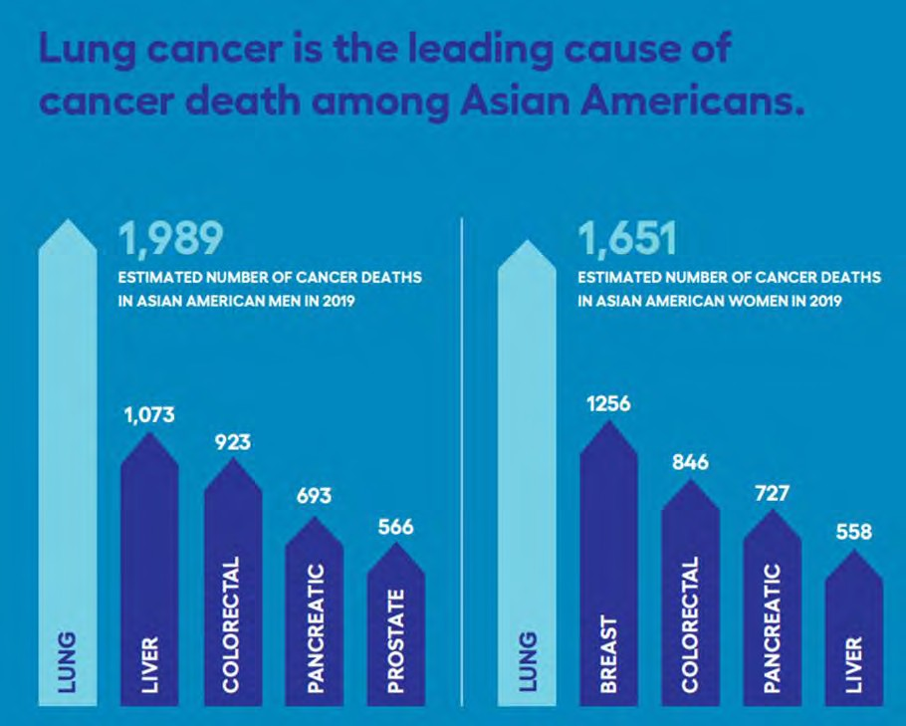
Lung Cancer in Asian Americans Who Do Not Smoke
Lung Cancer Facts
Disparities in Asian Americans and Cancer
Hidden Disparity: Lung Cancer in Asian Americans Who Do Not Smoke
Take Home Points
MEN
WOMEN
GO2 for Lung Cancer

Slide 4
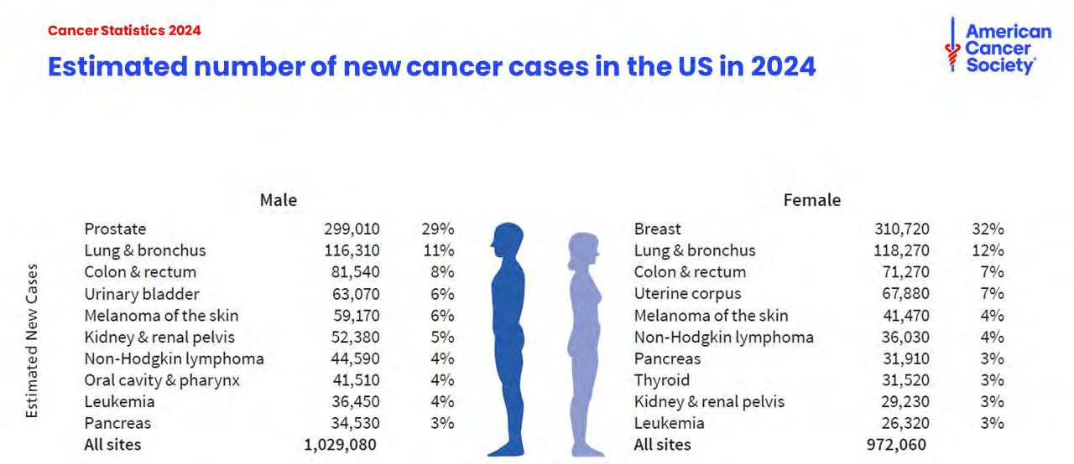

Slide 5
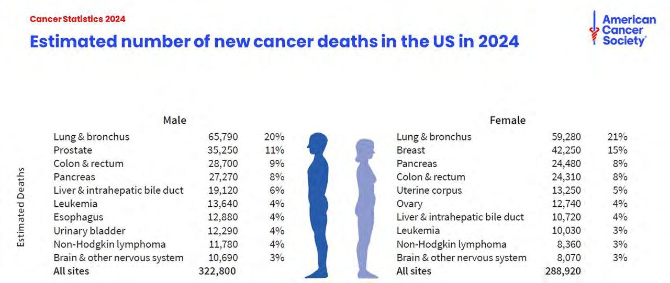

Slide 6

Smoking and Lung Cancer, BUT it’s not the whole story
The most important risk factor for lung cancer is
smoking
80 to 85% of all lung cancers
Risk is 20-fold higher in smokers than in nonsmokers.
Increasing age is a risk factor for lung cancer (70 years
median age)
US Preventive Services Task Force. Screening for Lung Cancer: US Preventive Services Task Force Recommendation Statement. JAMA. 2021;325(10):962–970. doi:10.1001/jama.2021.1117

Slide 7
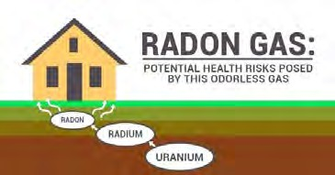
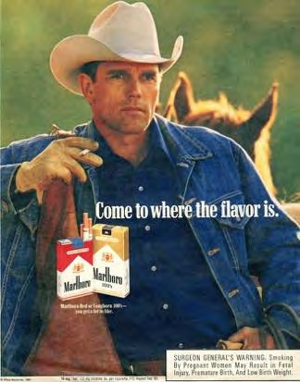
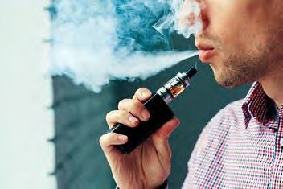
Other Risk Factors
Secondhand smoke, previous XRT, occupational exposures (arsenic, chromium, nickel, asbestos, radon), indoor and outdoor pollution
Additional risk indicators: Age, male, FH, acquired lung disease
(IPF), COPD, TB
Vaping (E-cigarettes) – (mid-2000s) – Vaping and smoking leads to 4x higher lung cancer risk than smoking alone
Former smokers (quit < 5 yrs) who vaped, had higher risk of lung cancer-related death than non-vapers
~ 15 to 20% of lung cancer in non-smokers
•
Alberg Chest 2013
J Oncol Res Ther 2024
ATS 2024

Slide 8
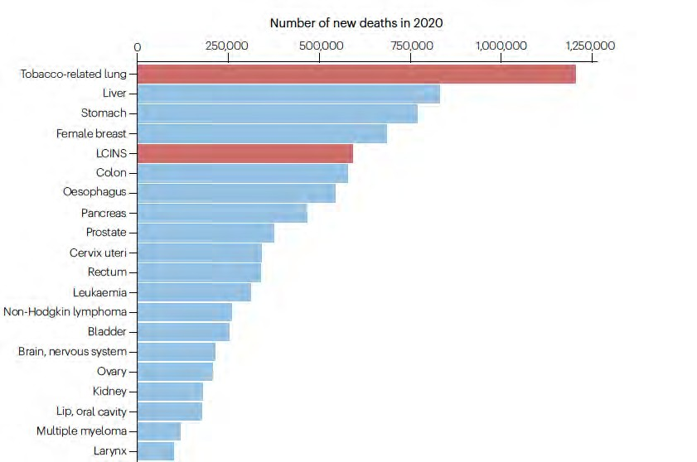
Non-smoking Lung Cancer Ranked 5Th in Global Cancer Deaths in 2020
More than 30 % of all lung cancer pts did not have a smoking history world-wide
LCINS: Lung cancer in individuals who have never smoked
LoPiccolo J et al. Nat Rev Clin Oncol 2024.
8

Slide 9
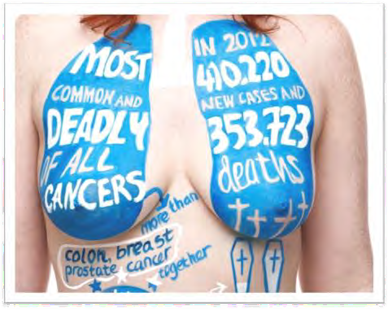
Dispelling Myths & Stigma, Raising Awareness
More people die of lung cancer than breast, colon, and prostate combined in the U.S. every year
Overall 5-year survival ~25%
versus 91%, 64%, and 97%
>50% of lung cancers occur in people who formerly or do not smoke
ACS 2024

Slide 10
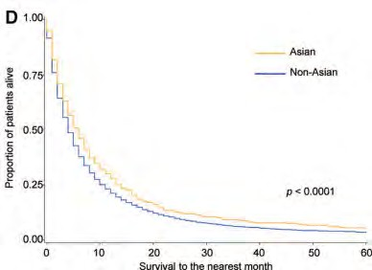
2024 American Cancer Society – Lung Cancer 5-year Survival: 2013 to 2019
25% for all stages
Asian: favorable prognostic factor independent of smoking status
JTO 2009
www.cancer.org

Slide 11
Mortality remains high, due to late diagnosis
Stage
% of lung CA
5-year relative survival (%)
Localized
24%
61.2
Regional
22%
33.5
Distant
46%
7.0
ACS SEER 2012-2018

Slide 12
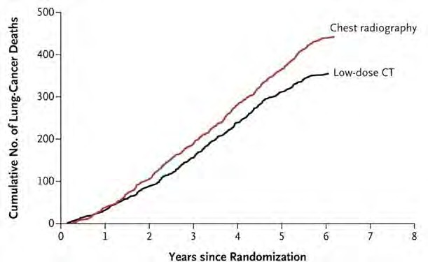
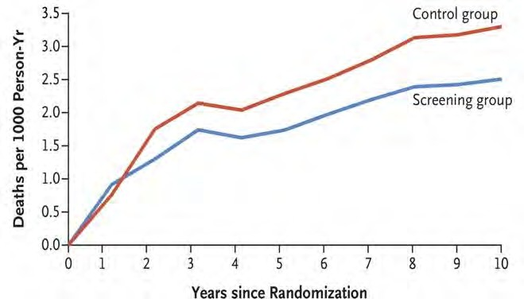
Annual screening for lung cancer recommended for high-risk adults
First ever USPSTF recommendation
(age 55-80, 30+ pack-years, smoked in last 15 yrs)
2013
Updated USPSTF recommendation
(age 50-80, 20+ pack-years, smoked in last 15 yrs)
2021
2011
2020
National Lung Screening Trial results published
NELSON Trial results published

Slide 13
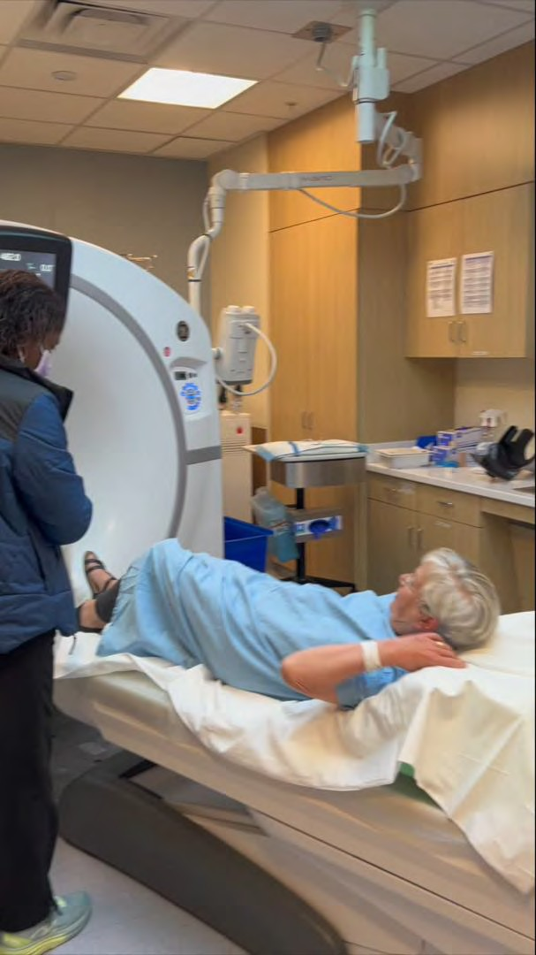

What is Lung cancer screening (LCS)?
1 min Low-Dose CT scan: NOT an XRAY
Annual CT scan
2021 USPSTF guidelines:
Age 50 – 80, currently smoke or 20 pack year history, quit within past 15 years

Slide 14
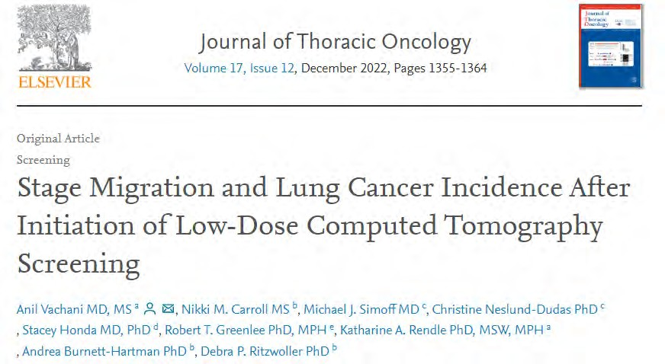
As LCS volume increases, more early-stage lung cancer picked up
As LCS volume increased:
0% Lung Cancer Dx in
2014
20% Lung Cancer Dx in
2019
Stage-specific incidence rates
increased for stage I cancer (AAPC = 8.0 [95% CI: 0.8–15.7])
and declined for stage IV disease (AAPC = −6.0 [95%
CI: −11.2 to −0.5])

Slide 15
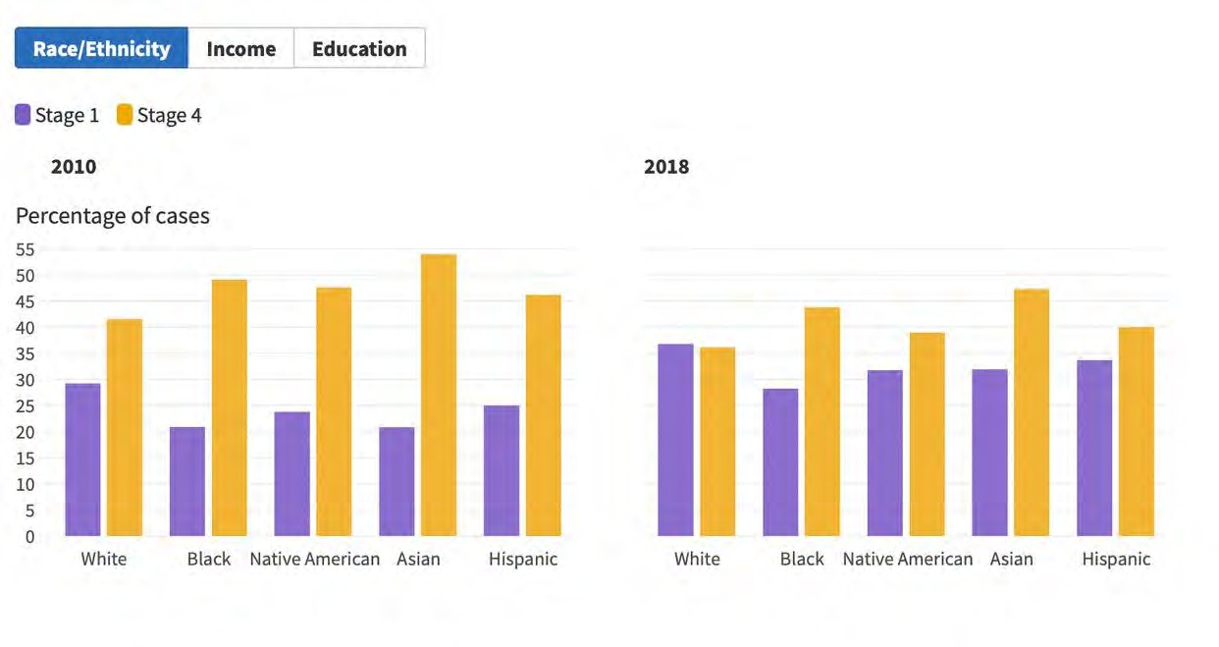
Asian Americans continue to be diagnosed more with Stage IV
Despite increase in LCS, Asian Americans continued to be dx with more Stage IV than Stage I vs. Caucasians
Stage IV predominant
Potter AL,BMJ. 2022 Mar

Slide 16

Asian American Disparities and Cancer
Fastest-growing US racial group – 24 million
Cancer - leading cause of death in both men and women, not heart disease!!
Historical prejudices, racism, cultural/language
barriers, “Model minority myth”
Only 0.17% of the total NIH budget funds Asian American Research
2% of clinical trial participants
“Our problems never make the headlines.” - Susan Shinagawa
JNCI 2022
CDC/NCHS 2021

Slide 17
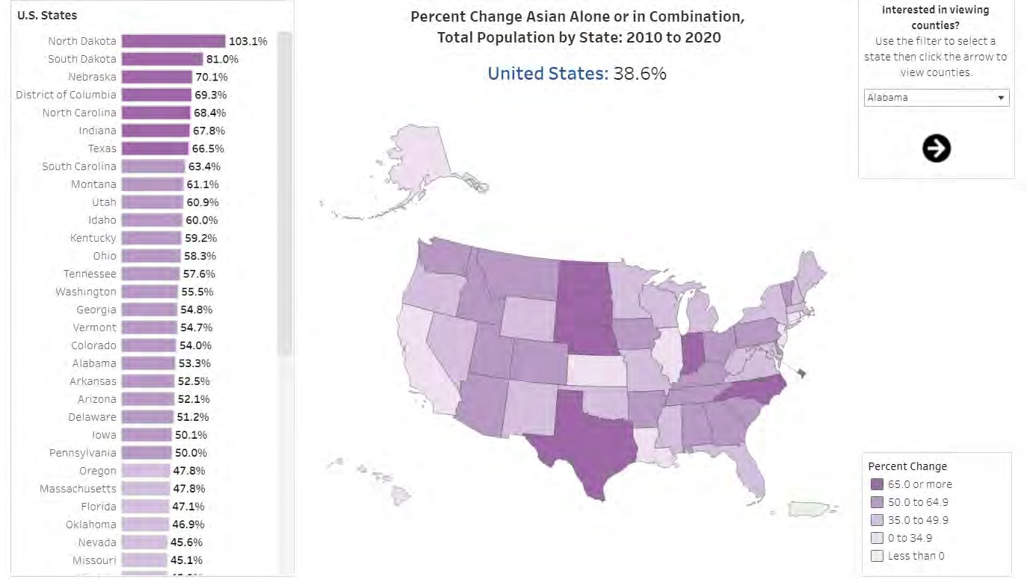
Asians are the most rapidly growing racial/ethnic group in the US
From U.S. Census

Slide 18
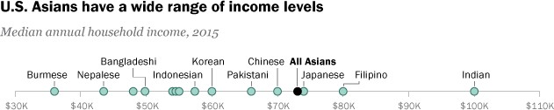
Asian Americans have the largest income spread
These two groups also have the highest and lowest income of entire U.S. population
From PEW Research Center

Slide 19
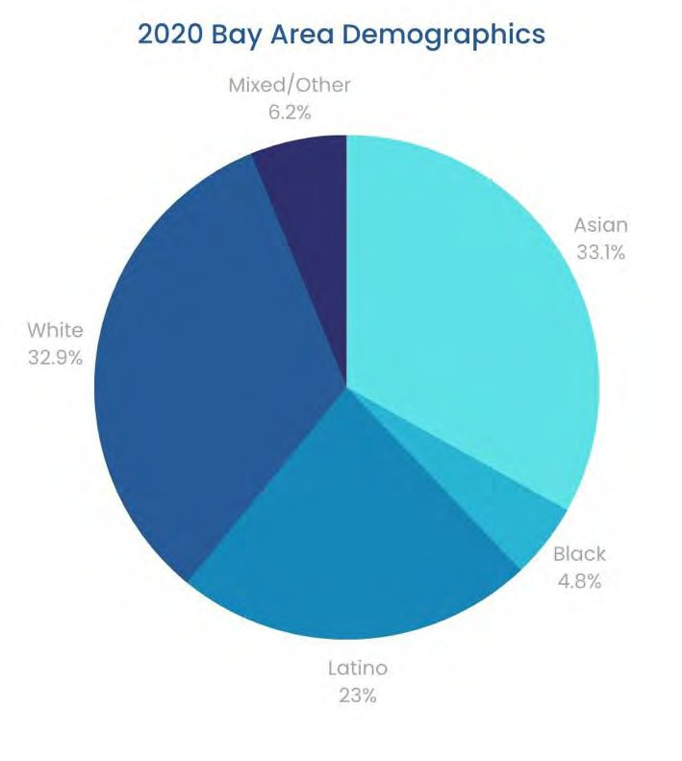
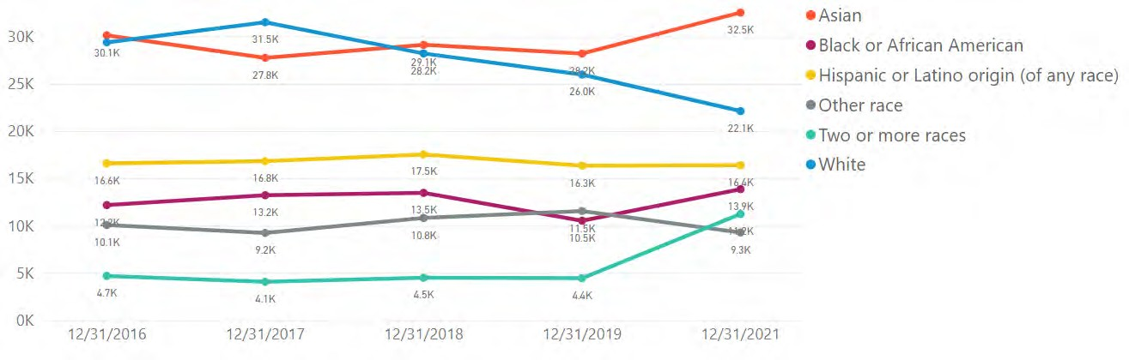
Asian Americans make up the largest racial group in the Bay Area: 33.1%
Largest group below the poverty line in San Francisco
US Census bureau 2020 https://sfgov.org/

Slide 20
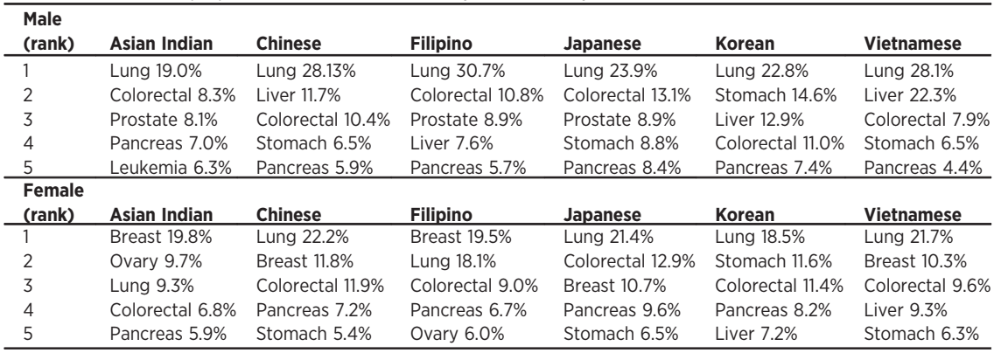
Lung cancer is a leading cause of cancer mortality among Asian Americans
Rank (based on age-adj mortality rate) & % (of all cancer deaths) of top 5 cancer sites, 1990-2008
Thompson CA, et al. CEBP 2016

Slide 21
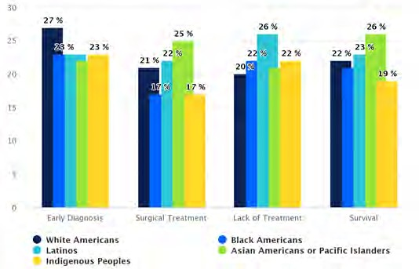
Racial distribution of Lung Cancer in Asian Americans
Asian Americans:
16% less likely to be diagnosed early
Highest incidence in the West Coast
Survival highest
American Lung Association 2023

Slide 22
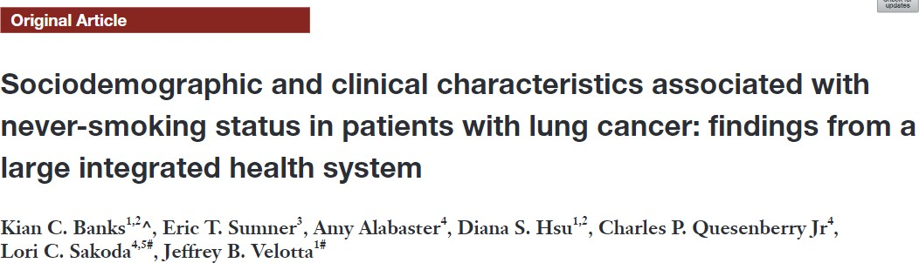
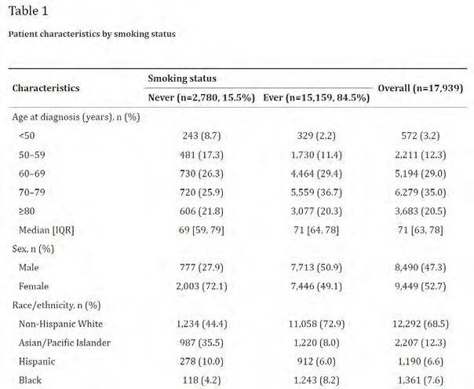
Women (52.7%) >> Men (47.3%)
84.5% Smokers
50.9% Men, 49.1%
Women
15.5% Non-smokers
72.1% are Women
Transl Cancer Res 2022;11(10)

Slide 23
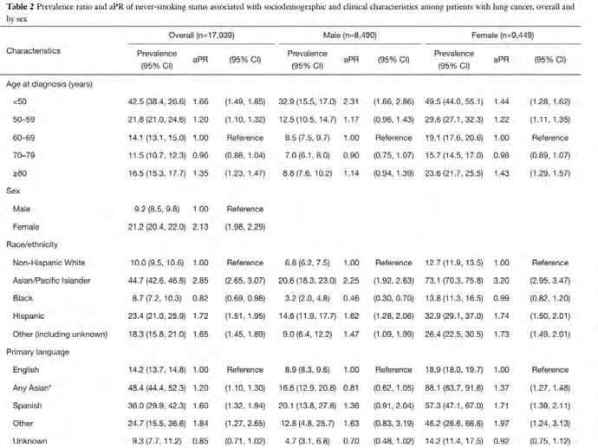
Characteristics associated with lung cancer patients who do not smoke
Patients with lung cancer who DO NOT smoke were more likely:
Female (72%)
Younger (<50y)
– Asian (35.5%)
Asian language
Adenocarcinoma
Dx with Stage IV or I

Slide 24
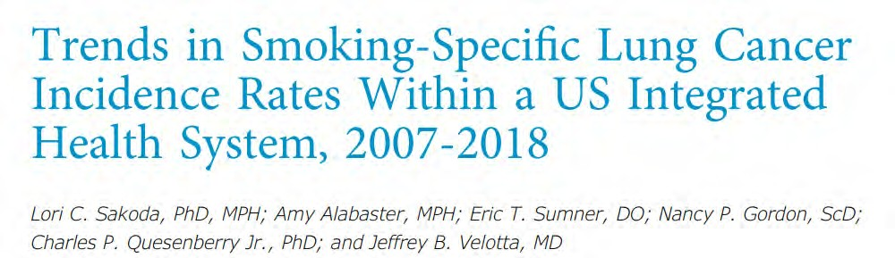
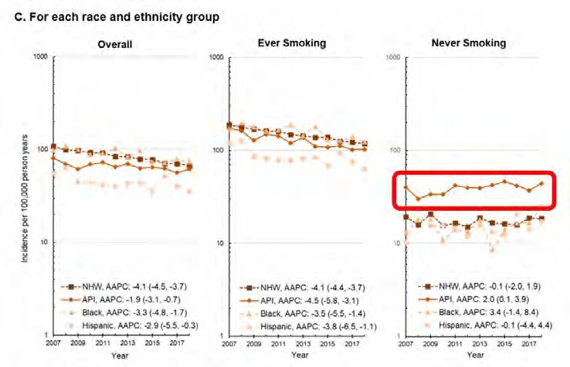
2007 – 2018, KP NCAL
•
Increasing 2% per
year in Asians who do
not smoke
Average annual percent change (AAPC): 2.0 (0.1, 3.9)
Sakoda LC Chest. 2023 Mar

Slide 25

Stanley Leung, MD

Slide 26
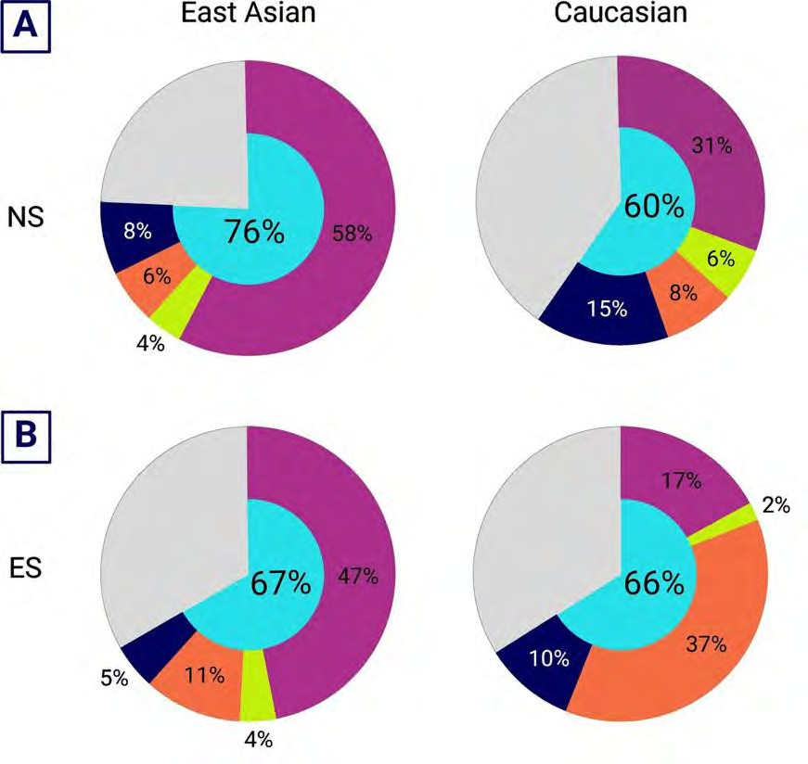
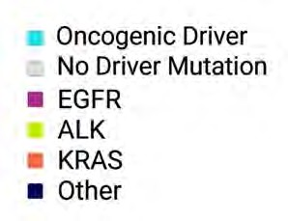


East Asians with lung cancer have different biomarkers vs. Caucasians
Non-smokers: EGFR in Asian vs. Caucasian 58% vs. 31%
EGFR
EGFR
Smoking hx: EGFR
47% vs. 17%
Wang P J Transl Med 2023 E Shum NYU courtesy

Slide 27
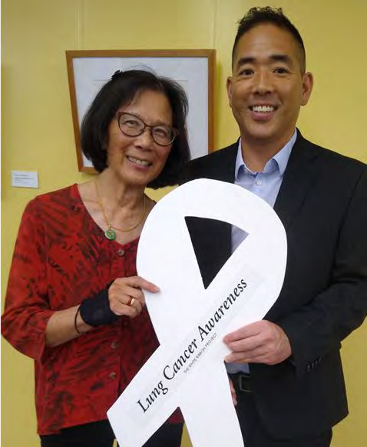
EGFR mutations are 2.7-fold higher in Asian vs. Caucasian women (IASLC)
EGFR mutations in KP NCAL
33.3%
22.9%
2013 to 2020
in KP NCAL
n=9834
NSCLC pts
NHW
62.6%
16.1%
Asian
White
Asian
Black
Hispanic

Slide 28

Hongtai Li, MD

Slide 29


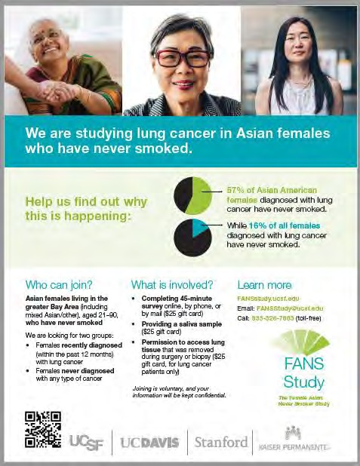





Slide 30




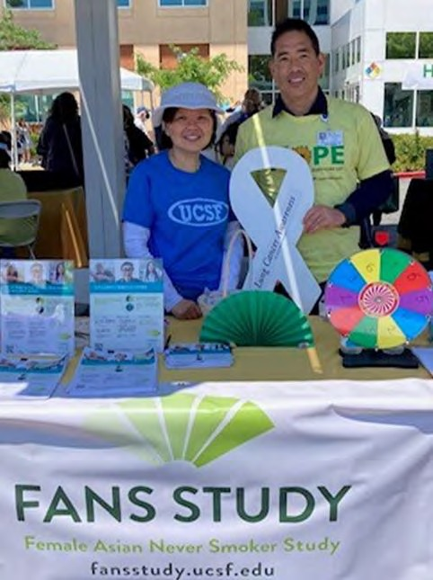
Elucidating lung cancer etiology among Female Asian Non-Smokers (FANS)
Multi-level risk factors, ancestry, and molecular profiling of lung cancer specimens in Asian Americans
Population-based Case-control study
- 600 lung cancer cases, 600 controls
Questionnaire, saliva, tumor specimen
353/600 cases, 507/600 controls (10/10/2024)
42% refusal rate (~50% passive refusal)
https://fansstudy.ucsf.edu/home

Slide 31
Taiwan Lung Cancer Screening in Never Smoker Trial (TALENT)
From 2015 to 2019, 17 medical centres participated
pos
pos
Non-smoking 55-75 y/o
lung cancer risks
Standard CE chest CT
Bx or F/U
CXR
neg
Low-dose chest CT Biomarkers (blood, urine) Questionnaire (FH, PH)
pos
Bx or F/U
Key inclusion criteria
55-75 y/oª
Never smoking or SI < 10 PY and had quit > 15 yrs
Having one of the following risks
Data cutoff: September 30, 2020
13,207 subjects screened, 12,011 enrolled
6009 (50%) with family history
Lung cancer family history (LCFH, ≤ 3-degree)
Passive smoking history
Chronic lung disease (TB, COPD)
Cooking index^{b} ≥ 110
Cooking without using ventilation
ª Subjects with lung cancer FH: >50 yrs or > the age at diagnosis of the youngest lung cancer case in the family
^{b} 2/7 x days with cooking by pan-frying, stir-frying, or deep-frying in 1 week (maximum=21) x Yrs with cooking
Negative CXR
TALENT Study Group, Lancet Resp Med 2024
31

Slide 32
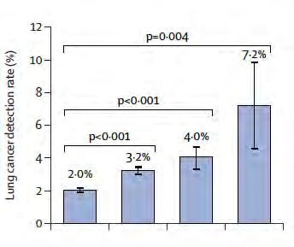
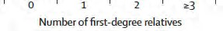



Key Messages of TALENT First Round T0 Results
Lung cancer detection rate: 318/12,011= 2.6%
(NLST: 1.1%, NELSON: 0.9%)
Invasive lung cancer: 257/12,011= 2.1%
LDCT(+): 17.4%; lung biopsy/surgery: 404 (3.4%)
A positive LDCT scan had 92.1% sensitivity, 84.6%
specificity, a PPV of 14.0%, and NPV of 99.7%.
Lung cancer diagnosis confirmed: 96.5% stage 0-1
(Stage 0: 19.2%, Stage 1: 77.4%)
Prevalence of lung cancer family history (LCFH) with vs without: All 3.3% vs 2.0%, IVAD 2.0% vs 1.6%
26.2% of participants were male
1.4% lung cancer detection rate in males
TALENT Study Group, Lancet Resp Med 2024
32

Slide 33
Asians who do not smoke: LCS comparisons to NLST and NELSON
 | TALENT | FANSS | NLST | NELSON
N | 12,011 | 201 | 26,722 | 7900
Screened population | Asian men and women 55 – 75 yo, non-smokers | Asian women 40 – 74 yo, non- smokers | Men and women 55 – 74 yo, ≥30 pack year | Mostly men 50 – 74 yo, ½ pk/day x ≥30 yrs
 | + 1 risk factor
Positive Screen | Solid nodule ≥6mm; GGO ≥5mm | LRADS 3 or 4: Solid,part solid nodule ≥6mm; | Nodule ≥ 4mm | Nodule vol and doubling time
 |  | GGO ≥30mm
Lung Cancer Rate | 2.1% | 1.5% | 1.1% | 0.9%
TALENT and FANSS: higher lung cancer detection rate than NLST and NELSON
Lancet Resp Med 2024, Shum ASCO 2023, NEJM 2020, NEJM 2011

Slide 34
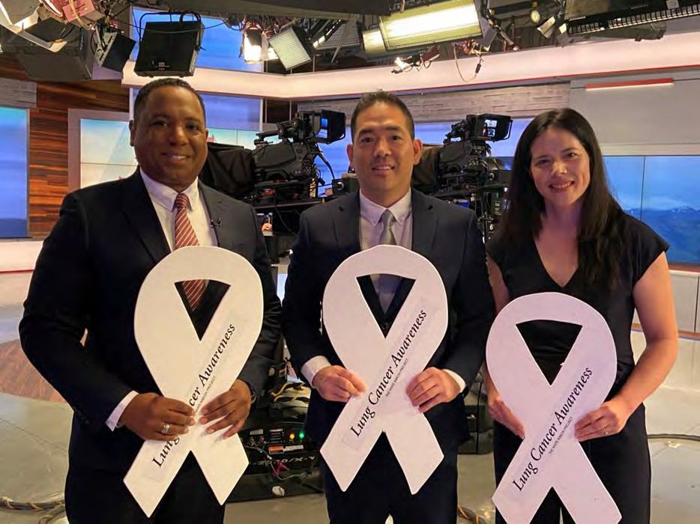
Take Home Points
Cancer is the #1 cause of death
in Asian Americans
Lung Cancer is the #1 cancer killer
Incidence is rising in Asian Americans who do not smoke
Be proactive about your health

Slide 35
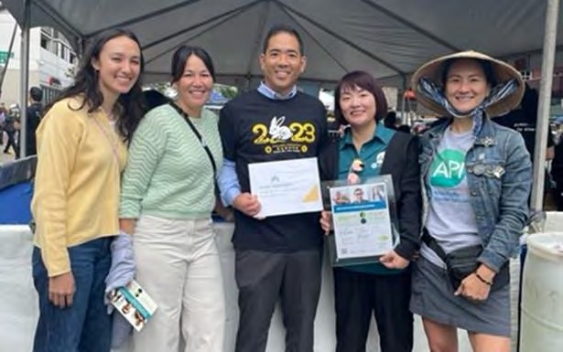
Call to Action: Lung Cancer in Asian Americans
Public Awareness: Let your family and friends know about Lung Cancer in Asian Americans
Promote Research in Asian Americans
TSF funded grant (2023 - 2025): “Increasing uptake in LCS in Asian Americans utilizing lay navigators”
DOR grant (2024 to 2026): “Increasing
universal biomarker testing in Asian
Americans utilizing RN navigators”

Slide 36

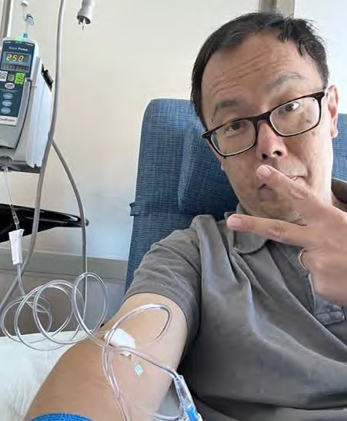
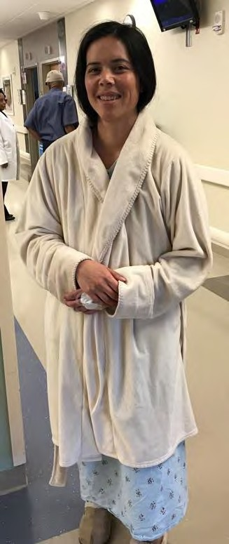
Thank you!!!
Jeffrey.b.velotta@kp.org @JVelottaMD

Slide 37

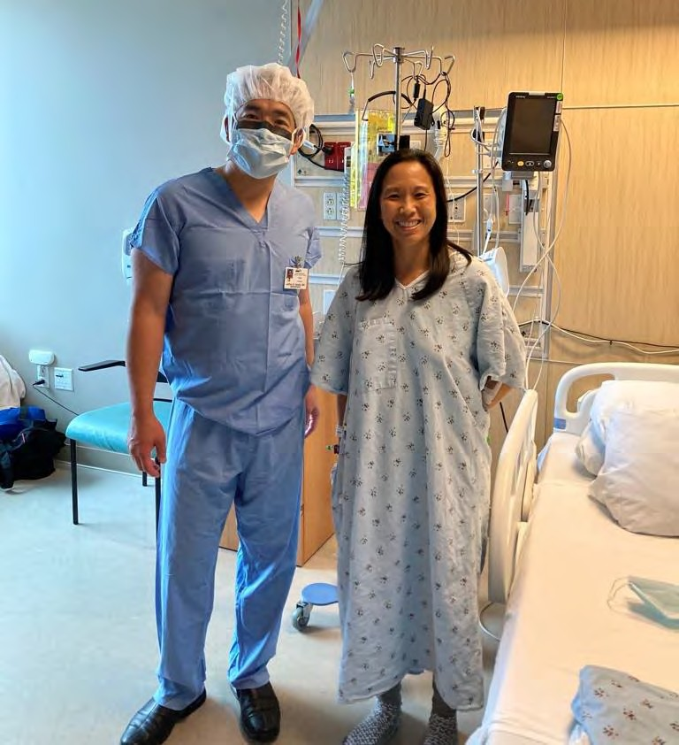
In memory of Kristi Chan (1975 – 2022)

Slide 39

Thank you!
Jeffrey.b.velotta@kp.org
@JVelottaMD

Slide 40
Extra Slides

Slide 41

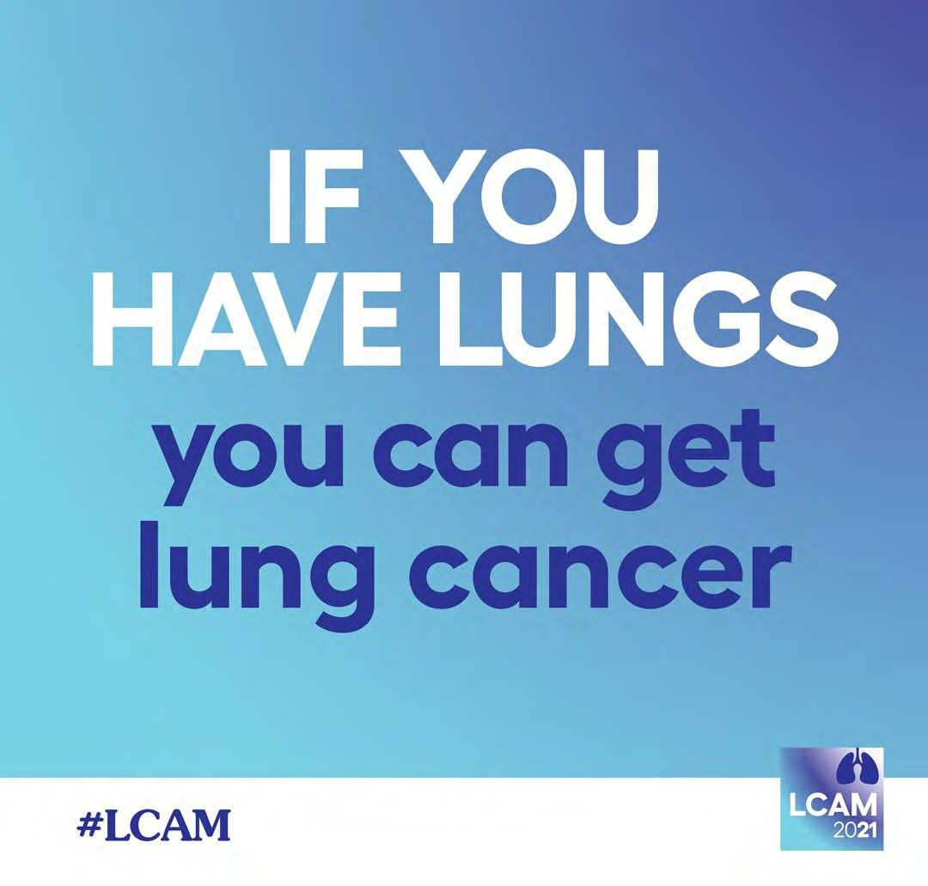


Slide 42
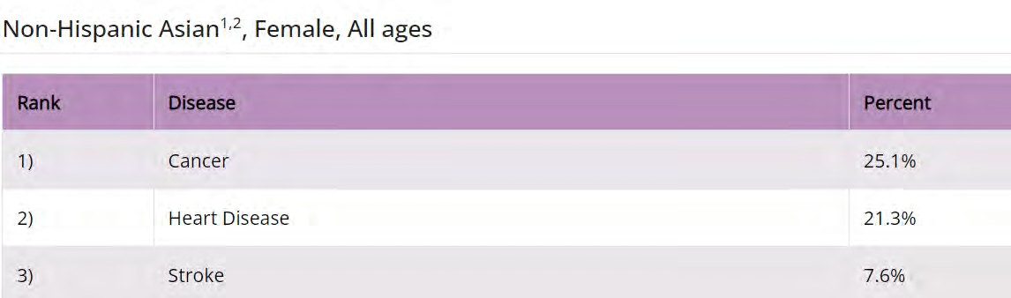
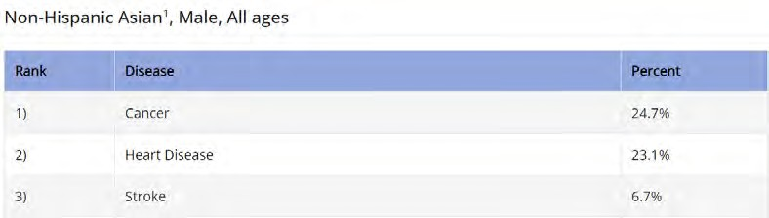

Slide 43
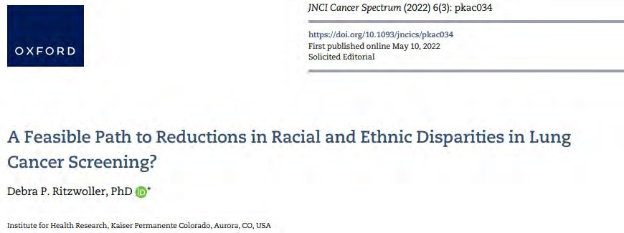
How do we fix the LCS conundrum?
Mandate quality measures at healthcare system and provider level
Financial incentives at
both levels
Involve Primary
Care Physicians

Slide 44

Asian American Disparities Research
20 million Asian Americans in US (2020 census)
Fastest growing racial/ethnic group in US (will increase in next decades)
COVID 19 and death toll on Asian Americans
3 racialized stereotypes in Asian American research
Model minority 2) Healthy immigrant effect 3)
Perpetual foreigner
Leading cause of death in Asian Americans (M/F) is CANCER –
24.8% and 25.5% - Not heart disease!
Yan BW J Gen Intern Med. 2021;36(11):3545–9
https://www.cdc.gov/women/lcod/2017

Slide 45


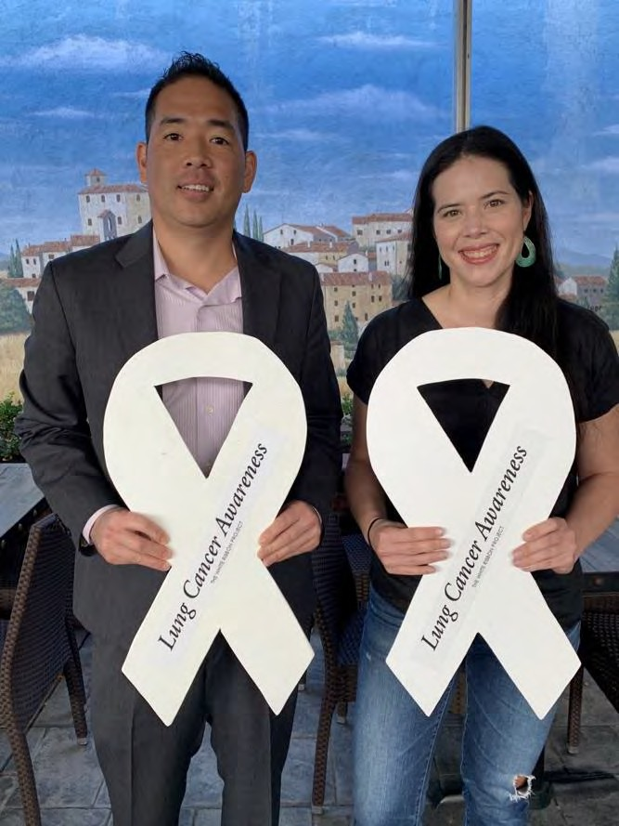

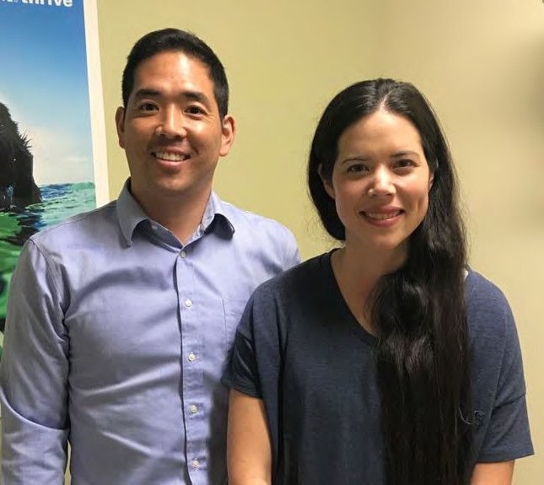

Susan Brim, MD
2021
2018
2019

Slide 46
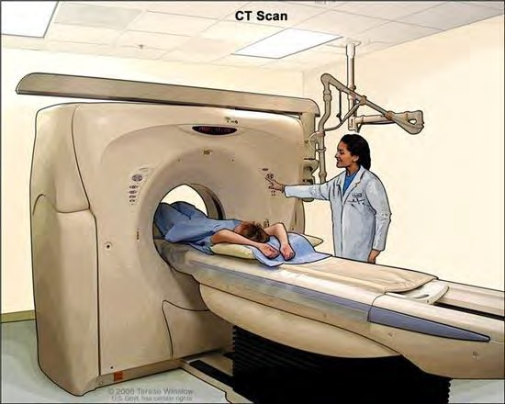
LCS is quick, easy and painless
5 to 10 min Low-Dose CT scan: NOT an XRAY
ANNUAL
LCS adherence is important! (60% of
cancers were caught in
additional f/u CT scans)

Slide 47
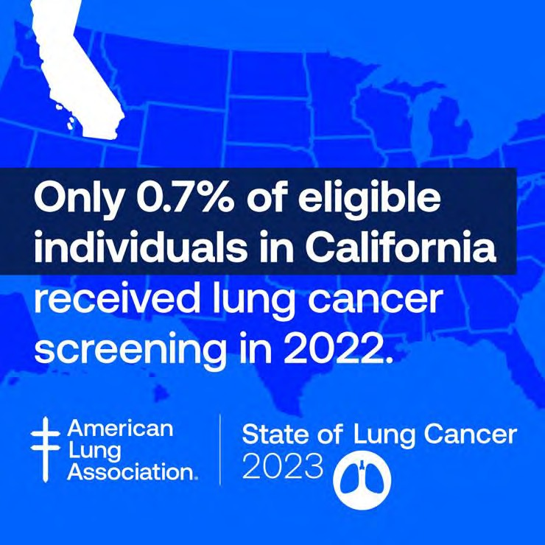
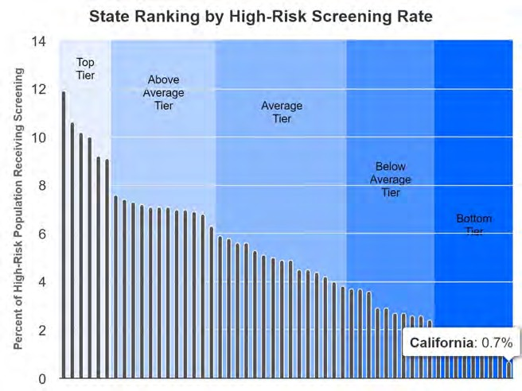

Poor uptake of LCS in CA
Only 4.5% (6% in 2022)of eligible U.S. adults have been screened so far
California is the WORST state at 0.7% (1% in 2022)
Source: American Lung Association. State of Lung Cancer 2023

Slide 48
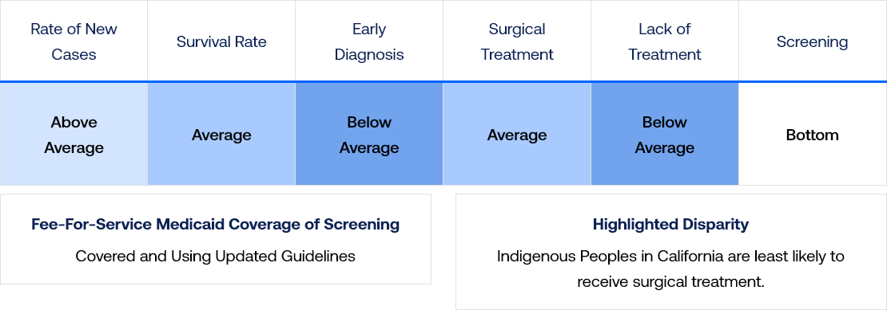
CA National Rankings for Lung Cancer
American Lung Association 2023

Slide 49


Sign up!
Jeffrey.b.velotta@kp.org
https://fansstudy.ucsf.edu/home
fansstudy.ucsf.edu

Slide 50
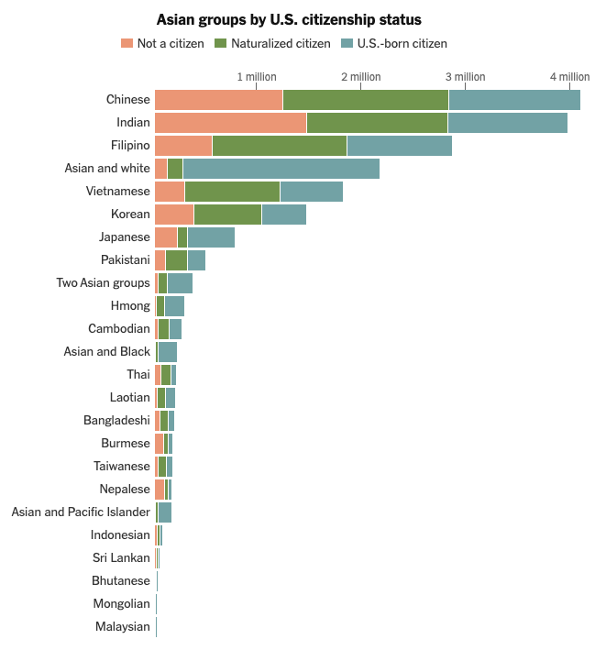
Asian American population is extremely diverse
Huge variation between Not a citizen, Naturalized citizen, or
U.S. born
Asian population to surpass 46 million by 2060
https://www.nytimes.com/interactive/2021/08/21/us/asians-census-us.html

